Slide 1














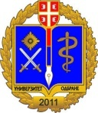
Development of master curricula for natural disasters risk management in Western Balkan countries
NEO preventive monitoring
TECHNICAL COLLEGE OF APPLIED SCIENCES UROŠEVAC- LEPOSAVIĆ
26.06.2018

Slide 2
Development of master curricula for natural disasters risk management in Western Balkan countries
Implementation
Quality assurance
Quality control plan of NatRisk project activities was adopted in January 2017.
Work package self-assessment reports planned for March and September 2017. are completed and delivered to the Project Management.
The Partner self-assessment report for September 2017. completed and delivered.
Contact with relevant institutions from Kosovo* regarding the procedure for defining the requirements for admission and enrolment of students and for the innovation of the existing classification of occupations in Kosovo*

Slide 3
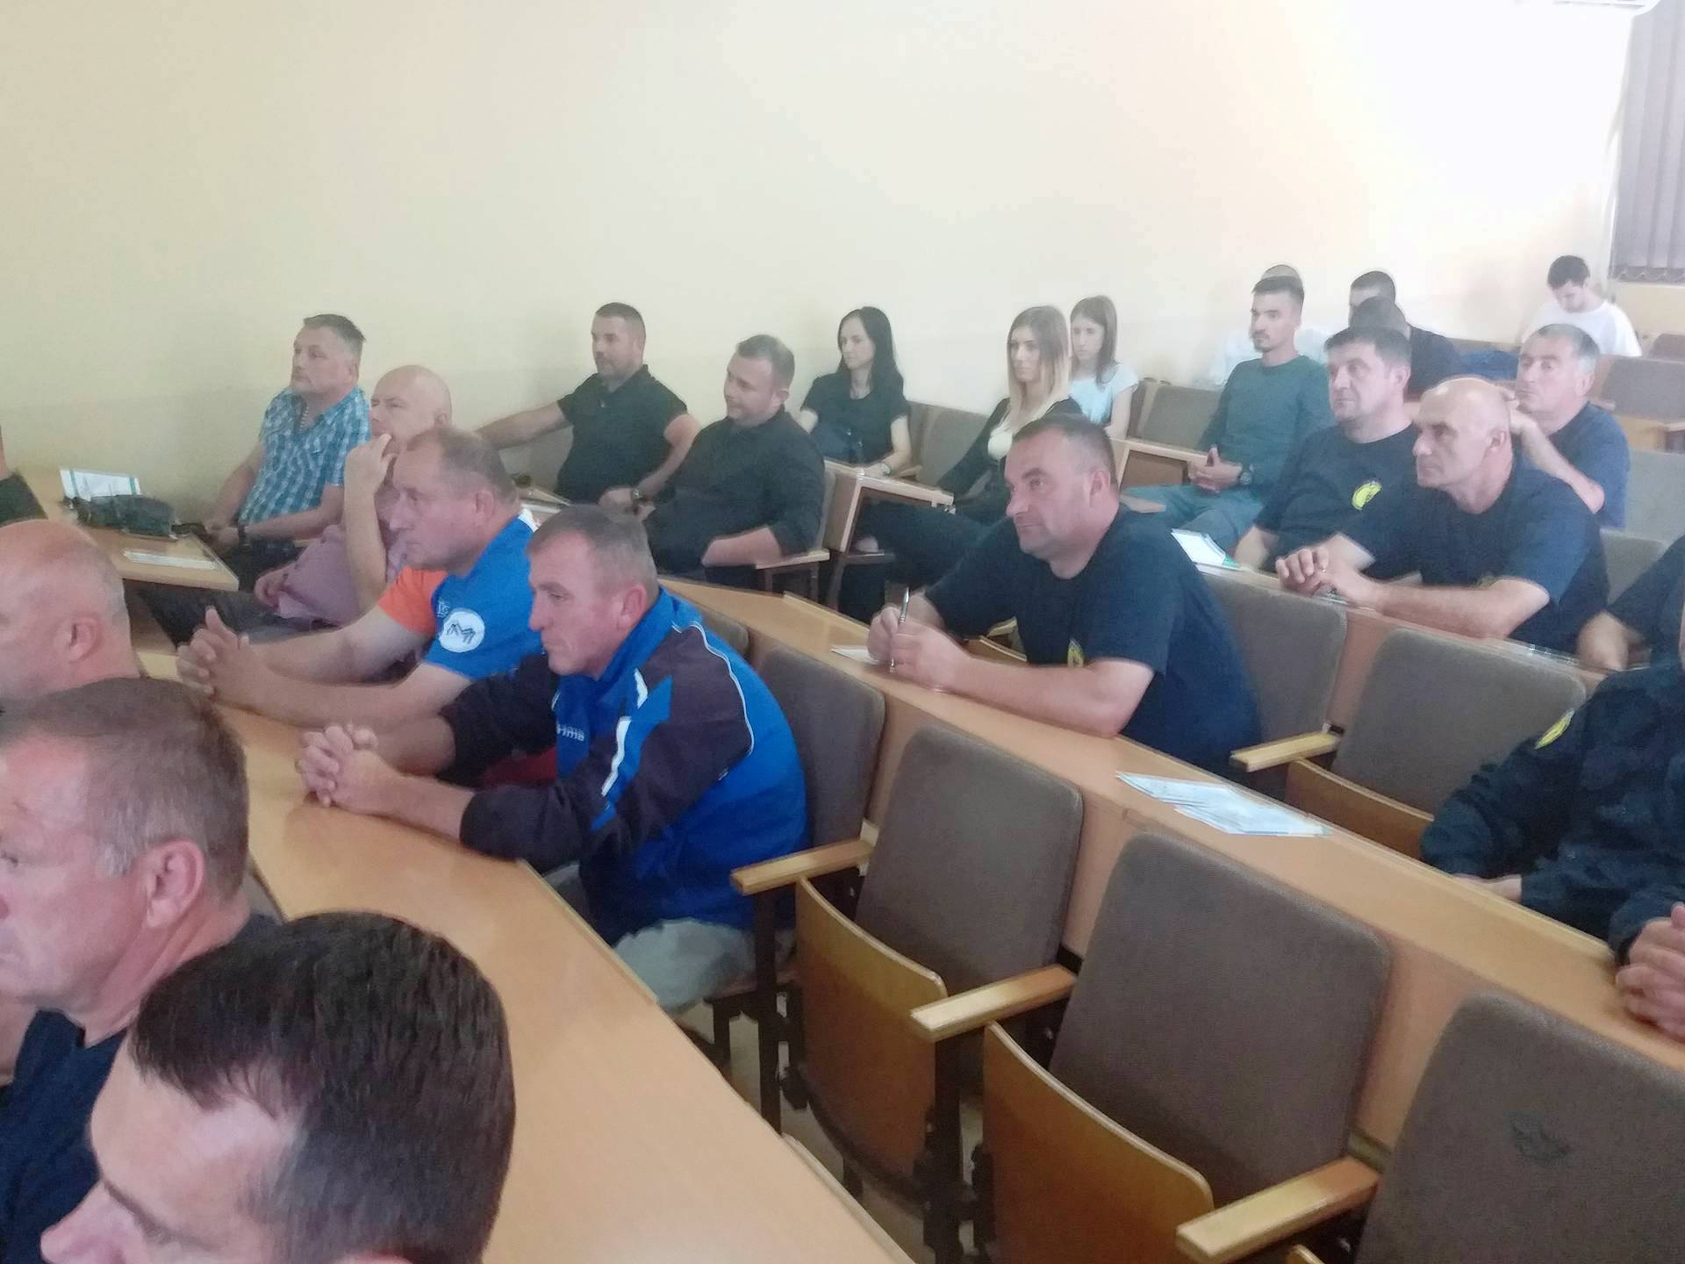
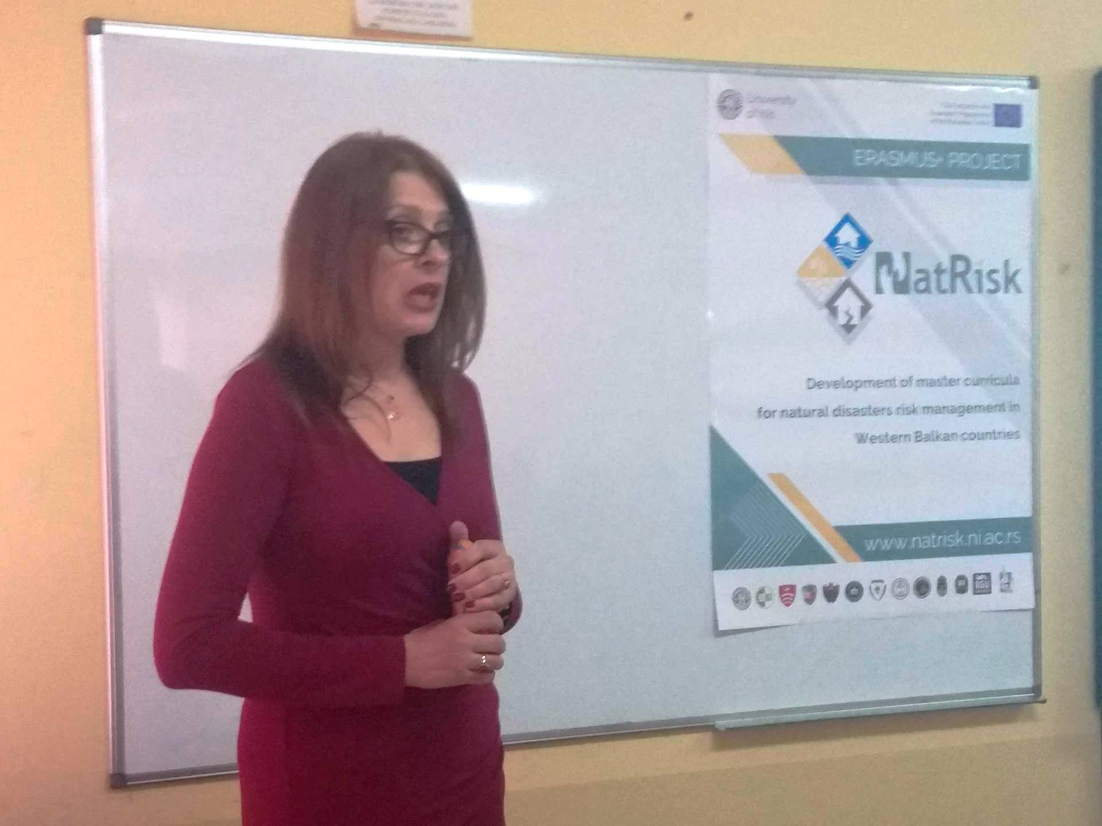
Development of master curricula for natural disasters risk management in Western Balkan countries
A two-day training for public sector and stakeholders regarding the the natural disasters risk management was organized and valuable feedback was obtained.

Slide 4
TCASU’ s Implementation of activities
Development of master curricula for natural disasters risk management in Western Balkan countries
An investigation of the area regarding the risk of natural disasters was conducted;
Survey was conducted based on questionnaires created by UNID wich were distributed to target groups (citizens, public sectors, students, etc).
The total 309 respondents participated the survey and the questionnaires were delivered to UNI.
The report on the existing disasters and risk management practices in Kosovo* was created and delivered to WP1 leaders (BOKU).

Slide 5
TCASU’ s Implementation of activities
Development of master curricula for natural disasters risk management in Western Balkan countries
Preliminary version of the new master curriculum for natural disasters risk management was prepared.
We have participated in several workshops in EU partner countries intended for training of teachers.
Based on project, we have 3 teaching staff mobilities, and so far one was successfully realised, at the beginning of June with our partners in Greece; the other two will be completed at the end of this year.
Level of budget: So far, TCASU have spent 70 % of the budget in line with financial plan.

Slide 6
Visibility and publicity obligations
Development of master curricula for natural disasters risk management in Western Balkan countries
For better transparency of the project we placed a banner on the TCASU’s official website linking to the official NatRisk website. (http://www.vtsurosevac.com/Sajt/Projekti.php ).
Students and teaching staff are actively involved in promotion of developed curricula. We also have organized a two-day training for public sector and stakeholders.

Slide 7
Equipment
Development of master curricula for natural disasters risk management in Western Balkan countries
Following the equipment purchase procedure for the implementation of the International project, "Development of master curricula for natural disasters in the Western Balkan countries" (NatRisk WeB, No. 573806-EPP-1-2016-1-RS-EPPKA2-CBHE-JP; European program Erasmus +) , TCASU, acquired following equipment:
  15 computers,
  4 projectors ,
  1 Smart Board,
  2 printers and
  1 TV set.
Specialized software "HYDRUS 2.X, PCPROGRESS, Educational site licence Level L4 3D Standard” and “ IBM-SPSS Statistics (Premium Faculty Pack Bundle) Permanent License" were also purchased.

Slide 8
Equipment
Development of master curricula for natural disasters risk management in Western Balkan countries
The equipment will be used for:
teaching process, lectures, exercises and practical work at the specialist program Disasters Risk Management and Fire safety, established under the NatRisk project, and whose accreditation process has already been initiated;
training of students for effective decision-making in the case of natural disasters;
simulation of different scenarios that may occur due to natural disasters in the virtual environment and how to manage such situations;

Slide 9
Equipment
Development of master curricula for natural disasters risk management in Western Balkan countries
The equipment will be used for:
training of administrative and teaching staff how to react in the case of natural disasters;
training of local community how to behave and react in the case of natural disasters;
conducting scientific research regarding the potential natural disasters risk in the environment and publishing of the obtained results in the scientific journals;

Slide 10
Curriculum development projects
Development of master curricula for natural disasters risk management in Western Balkan countries
New specialist professional studies curricula for natural disasters risk management was developed and courses and syllabi are defined. The accreditation process is still in progress.
The new study program will last one school year, and students will be awarded with 60 ECTS. The new study program is in line with Bologna requirements and EU best practice.
The issues regarding the methodology, learning outcomes, module templates, etc are harmonized with the guidelines and recommendations of EU project partners in the Workshops.

Slide 11
Curriculum development projects
Development of master curricula for natural disasters risk management in Western Balkan countries
Regarding the students’ mobility, students are informed about developed new master curricula and provided internships in WB and EU partner countries and they will be given opportunity to study in EU within the Special Mobility Strand and 4 students from our school will be exchanged by October 2019.
Student’s feedback through the self-evaluation of new study program curricula will be one of the main indicators of the project quality.

Slide 12
Staff training/teacher upskilling and mobility activities & Student mobility
Development of master curricula for natural disasters risk management in Western Balkan countries
The TCASU teachers participated in the teaching staff trainings aimed at educating WB teachers about innovative teaching methods, as well as improving their professional knowledge, which were organized in EU partner institution. Our team of teachers participated the following trainings:
Training of teaching staff at Obuda University- OE, Budapest, Hungary, from 23rd to 27th May 2017
Training of teaching staff at Middlesex University-MU, London, United Kingdom, from 27th June to 1st July 2017.

Slide 13
Staff training/teacher upskilling and mobility activities & Student mobility
Development of master curricula for natural disasters risk management in Western Balkan countries
Training of teaching staff at University of Messina, UNIME, Italy- from 19th to 21st September 2017.
Our team of teachers also attended SC, PMC, QAC, Inter-project coaching meetings held at the University of Defence (UNID), Belgrade from 6th to 9th of March 2018.
We have signed the inter-institutional agreements with partners KPA, TUC and VSUP for special mobility strand for teachers. The first mobility was realized at the beginning of June in TUC- Greece.

Slide 14
Impact
Development of master curricula for natural disasters risk management in Western Balkan countries
Seven new master programmes in NDRM at the WB partner HEIs that will be developed, accredited and implemented.
Three new training programmes in NDRM (one per each WB partner country) with training materials for public sector and citizens developed and conducted.
Retraining the teaching staff with up-to-date knowledge in NDRM to teach on the new master programmes.

Slide 15
Impact
Development of master curricula for natural disasters risk management in Western Balkan countries
TCASU together with other partners actively participate in all activities and provide all necessary legal and other preconditions in order to enable smooth implementation of the project.
TCASU purchased necessary equipment and will develop appropriate laboratory classes.
The expected goals of the project will be fulfilled through accreditation of newly developed specialist professional study programme in natural disasters risk management and enrolment of the first generation of students during the lifetime of the project. This will enable sustainability of project deliverables in the following years.
In accordance with the objectives of the project, the target groups are students, teaching staff, members of public sector actively involved in reducing of disaster risks and citizens who want to improve their knowledge and practical skills applicable in natural disasters situations.

Slide 16
Quality of the partnership and cooperation
Development of master curricula for natural disasters risk management in Western Balkan countries
The Management structure : 2 Consortiums one from the EU partner countries, and one from Western Balkan partners.
Project communication is supported by communication tools and Internet collaboration platform.
A self-check mechanism for the work package leaders and other participants provide an early warning system to identify deviations from the work plan and make it possible to establish contingency plans.
The day-to-day coordination and communication among partners keep the project aligned with the project plan and reduce the risks associated with project activities.

Slide 17
Quality of the partnership and cooperation
Development of master curricula for natural disasters risk management in Western Balkan countries
All partners co-finance project for proper work and publication of some dissemination results, while the WB partners will additionally co-finance accreditation of their new study programs.
All necessary documentation regarding the accreditation was submitted to Accreditation Commission and accreditation process is still in progress. We expect positive answer soon, and we hope that new school year will start as planned.

Slide 18
Relevance of activities in relation to project objectives
Development of master curricula for natural disasters risk management in Western Balkan countries
The project is designed in the way that can deliver tangible and sustainable benefits to its target group. Since in this area there is no special service, and therefore no experts, for disasters risk management, the need for educated staff is more than evident.
Since the target groups of the project are students, citizen and public sector, the project objectives are well formulated and the positive outcome of the project is likely to be achieved since it will benefit for both population and environment.
The project so far was feasible within the given time frame.
All objectives and activities regarding the work packages were completed in due time.

Slide 19
Relevance of activities in relation to project objectives
Development of master curricula for natural disasters risk management in Western Balkan countries
The project is well designed and cooperation between the partners and management is at highest level.
The project is flexible enough and allows changes regarding the needs of each institution and public sector, which is of great importance for all partners since there are different disaster risks than need to be manager and to which environment that partners are “covering” is exposed to.
The real outcome and the results of the project will be discussed upon the implementation and completion of the project.

Slide 20

Thank you for your attention
Development of master curricula for natural disasters risk management in Western Balkan countries

